Slide 1
The Pencil
2013 Tropfest Finalist
Produced, written and directed by Christo Erasmus

Slide 2
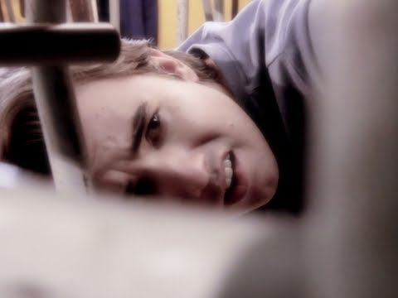
The Pencil
http://international.tropfest.com/ny/2013/06/23/the-pencil/
An unfulfilled school cleaner feels that he doesn't fit in. A pencil will show him that it's time he remembered what his true purpose is… he needs to save her.

Slide 3
Review on ‘The Pencil’
The following review reminds you of the sequence of events. You don’t need to take on the same opinion of this reviewer, however it may help you to analyse the short film.
https://ramblertimes.wordpress.com/tag/tropfest-2013/

Slide 4
AnALYSING The Pencil
1. Describe how the protagonist first encompasses an element of Discovery from the opening scenes. Use the rubric to help you - Discovery can encompass the experience of discovering something for the first time or rediscovering something that has been lost, forgotten or concealed. Discoveries can be sudden and unexpected, or they can emerge from a process of deliberate and careful planning.
2. How was the Discovery evoked? evoked by curiosity, necessity or wonder.
3. How was the Discovery confronting and provocative?
4. How did it lead us to new worlds and values, stimulate new ideas, and enable us to speculate about future possibilities?
5. Discoveries and discovering can offer new understandings and renewed perceptions of ourselves and others. How did this occur within The Pencil?
6. How was the Discovery transformative for the individual?
7. How was the discovery questioned or challenged when viewed from different perspectives?
8. The ramifications of particular discoveries may differ for individuals and their worlds. How did this occur within The Pencil?
Relate to Discovery Rubric

Slide 5
Technique Analysis
Now that you have the basis of the discovery, you need to link it to the HOW.
HOW = techniques
Text type = Short film
Filming techniques are required to analyse the discovery and how it creates meaning for each of the previous questions.
Use the TECHNIQUE ANALYSIS folder on Edmodo to help you revise techniques
Watch the film again and reword your answers to include the techniques.
Building a strong analysis

Slide 6
Creating an Analytical Paragraph
Using the same structure are we did in Year 11 –
TEEx?L
T = thesis statement (do not introduce the text YET. It needs to focus on the main idea of the paragraph. Build a thesis statement from the Rubric
‘Inbetweenie’ – the in-between sentence to state the text and how it demonstrates the thesis statement
Ie; The Tropfest short film, The Pencil, highlights….
E = Example
E = Explain
x? = Repeat this for as many techniques as you can – preferably 3-4 now that you are in Stage 6
L = Linking statement – reword thesis specifically to the text.
TEEx?L
Your QUESTION;
How has the concept of discovery been conveyed in the short film, The Pencil?
Use ‘Cheat Sheet’ to be sophisticated and combine the two E’s

Slide 7
