Slide 1
Painting Pictures With Words…
Year 11 Module A – transition to Year 12 Experience Through Language: Distinctively Visual.

Slide 2
Defining The module
In context of the rubric:
Anything WITHIN THAT TEXT that provokes an image you can physically see or imagine
It provokes an image WITHIN THAT TEXT which is connected to a CLEAR attitude/value/perspective.

Slide 3
Defining Image
Actual or mental picture – a picture or likeness of somebody or something, produced either physically by a sculptor, painter or photograpger, or formed in the mind by aural, written or spoken means
A very typical or extreme example of something
Eg. The very image of evil, greed, beauty
A person or thing bearing a close likeness to somebody or something else
Eg. She’s the image of her father
A figure of speech, especially a metaphor or simile
IMAGE IS THE IDEA BEHIND WHAT YOU SEE/VISUALISE

Slide 4
POWER
Examples/types of images
What other words can you associate with this image?
Eg. Strength
Using language devices, create a sentence to ‘paint a picture with words’.

Slide 5
Nation
Examples/types of images
What other words can you associate with this image?
Eg, Patriotic…
Using language devices, create a sentence to ‘paint a picture with words’.

Slide 6
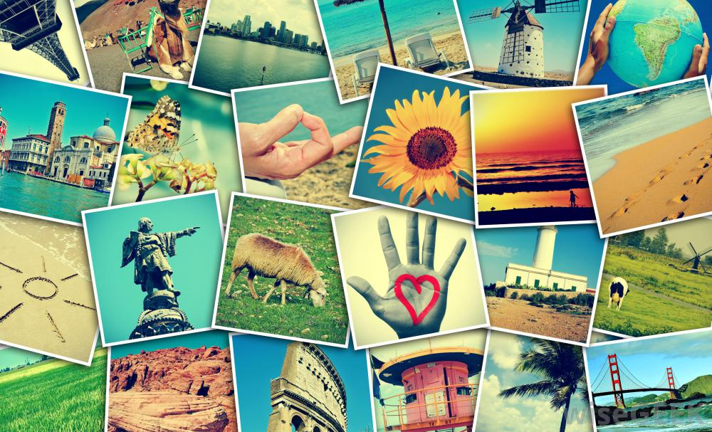
Can you identify other categories of images?
War
Peace
Love
Racism
Violence
Friendship
Travel

Slide 7
Activities
Using background knowledge;
Compose a journal entry detailing your most memorable image of school.
Why is this image so significant?
How is this image constructed in your memory?
Select a significant visual text
Take three photographs of your favourite place. Choose your favourite one of the three.
In a paragraph, explain why this image is distinctive from the others?

Slide 8
Activities
Select a significant written text
Identify a memorable image from your favourite book/poem.
In a paragraph, explain why this image is so important to the text. How does it add to the meaning?
Select a significant spoken text.
Identify an image from a family story/incident that ha been relayed to you.
In a paragraph, explain why this images is so significant to you.

