Slide 1
PURPOSE OF MAESTRO – What Goldsworthy wants us to EXPERIENCE or understand (through Paul’s EXPERIENCES):
Growth and maturity
Relationships (Paul & Keller, plus Paul’s other relationships, plus Keller & his family)
Reflection on life and value of hindsight
Self discovery
Escapism (Keller and his past)

Slide 2
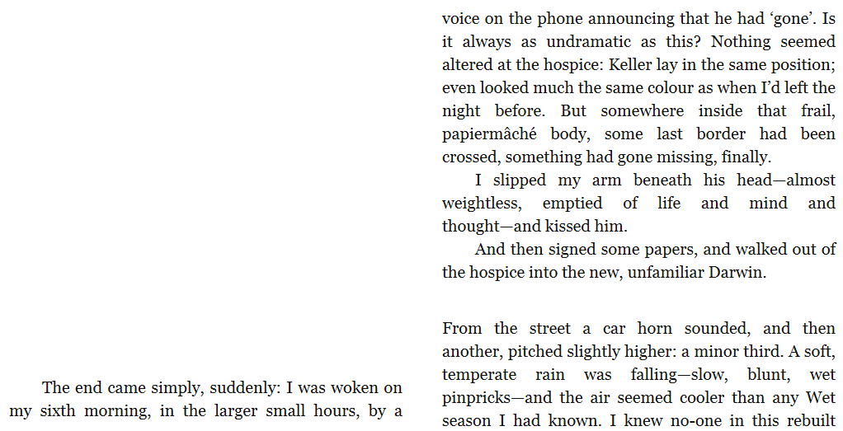
Keller’s Death and Paul’s reflection pg 146-49

Slide 3
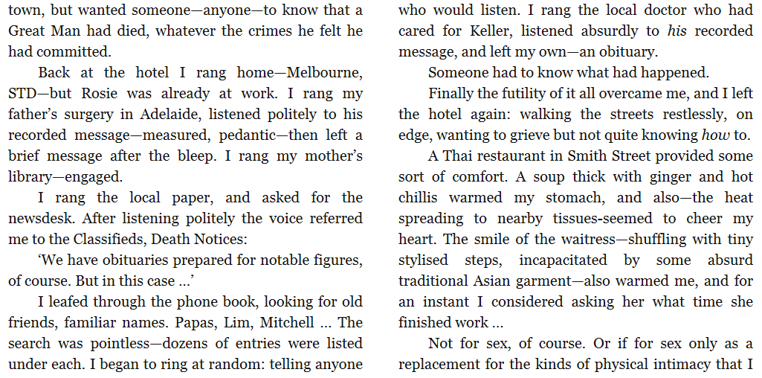

Slide 4
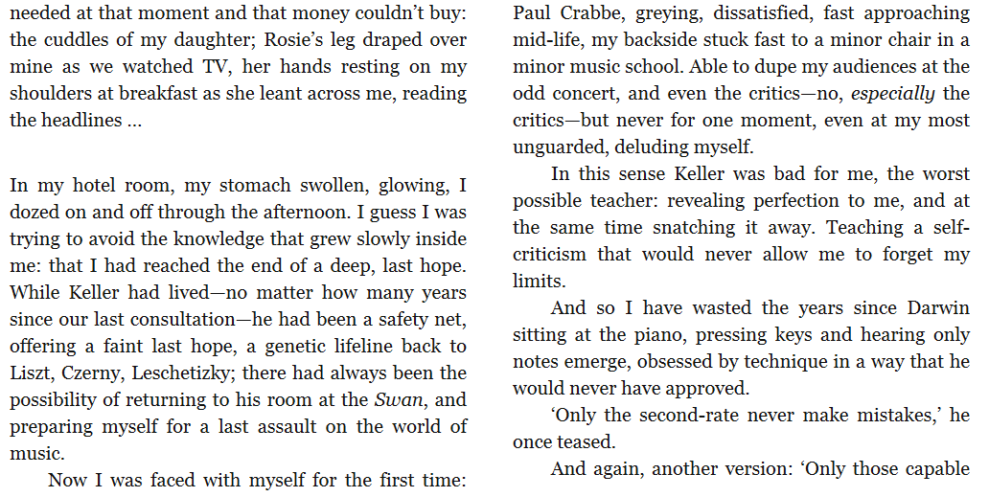

Slide 5
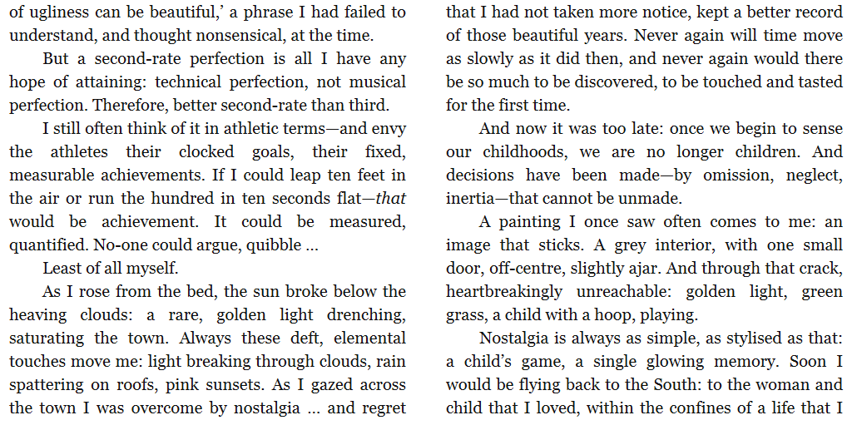

Slide 6
