Slide 1
PURPOSE OF MAESTRO – What Goldsworthy wants us to EXPERIENCE or understand (through Paul’s EXPERIENCES):
Growth and maturity
Relationships (Paul & Keller, plus Paul’s other relationships, plus Keller & his family)
Reflection on life and value of hindsight
Self discovery
Escapism (Keller and his past)

Slide 2
Read Pgs – 110-111?
Extract 7 – Keller’s Tattoo
Complete ‘Image Analysis Pro Forma’ – How does the description of the tattoo reveal ideas about Paul’s maturity and his changing relationship with Keller? How does the image reveal ideas about Keller’s past and his need for escapism?
Look for these techniques and label in your book – they may be multiple examples each:
Adjectives Punctuation (Colon) Short sentences
Metaphor Adverbs

Slide 3
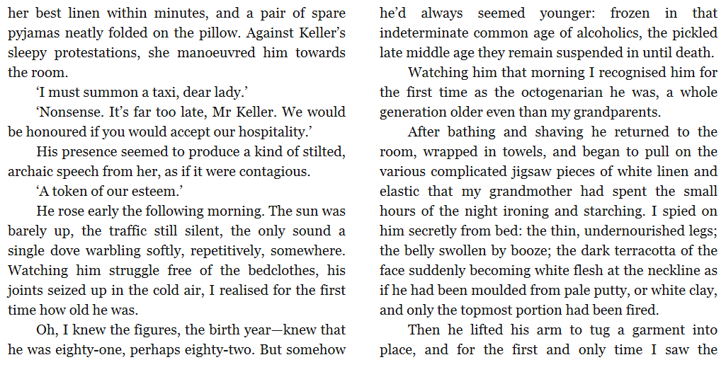

Slide 4
