Slide 1
PURPOSE OF MAESTRO – What Goldsworthy wants us to EXPERIENCE or understand (through Paul’s EXPERIENCES):
Growth and maturity
Relationships (Paul & Keller, plus Paul’s other relationships, plus Keller & his family)
Reflection on life and value of hindsight
Self discovery
Escapism (Keller and his past)

Slide 2
Read Pgs – 66-69
DISTINCTIVE IMAGE 6 – Keller’s Scrapbook
Complete ‘Image Analysis Pro Forma’ – How does the description of the scrapbook reveal ideas about Paul’s immaturity? Here we get a glimpse into Keller’s experience of hindsight. How does this, along with the description of the scrapbook, reveal ideas about Keller and his escape from his past?
Italics Metaphor Juxtaposition
Capitalisation Adjectives Connotations Oxymoron
Short sentences Simile Metaphor

Slide 3
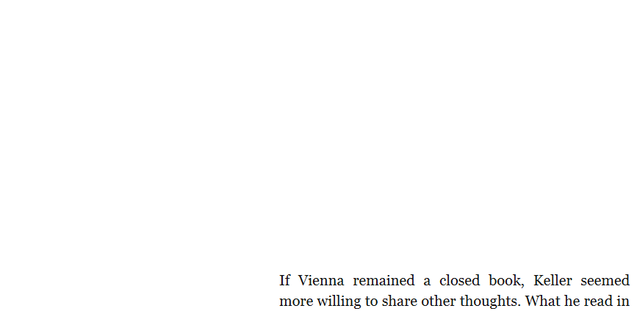

Slide 4
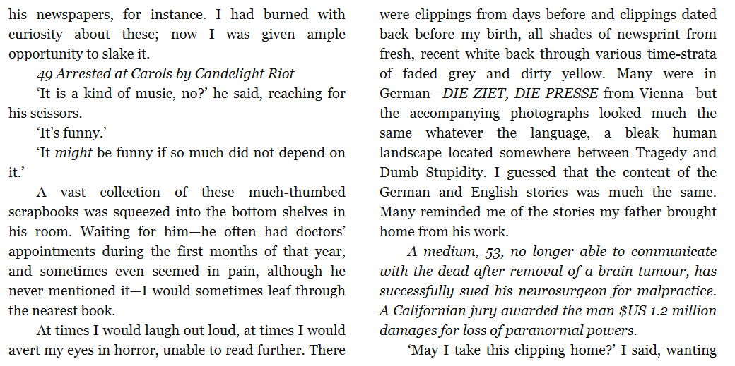

Slide 5
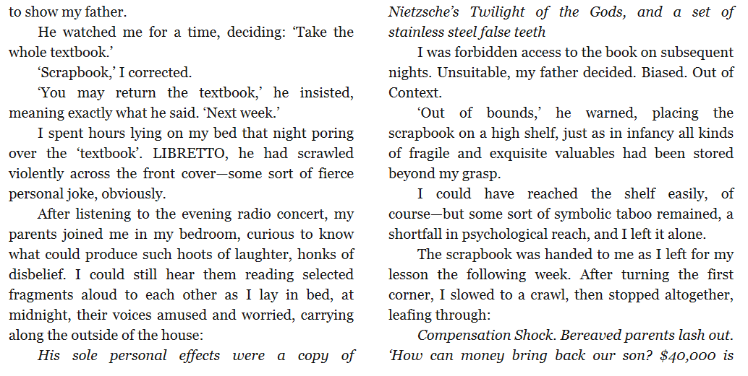

Slide 6
