Slide 1
PURPOSE OF MAESTRO – What Goldsworthy wants us to EXPERIENCE or understand (through Paul’s EXPERIENCES):
Growth and maturity
Relationships (Paul & Keller, plus Paul’s other relationships, plus Keller & his family)
Reflection on life and value of hindsight
Self discovery
Escapism (Keller and his past) Grief and Loss

Slide 2
Read Pgs – 46 and 66
DISTINCTIVE IMAGE 5 – Vienna in the 1930s
Complete ‘Image Analysis Pro Forma’ – How does description of Vienna in the past, and Keller’s memories, help to convey his loss and grief and need for escapism?
Ellipsis Tone Cultural allusion
Short sentences Verbs Sarcasm
Adverbs Jargon Pun Italics
Extended Metaphor Capitalisation Rhetorical Q

Slide 3
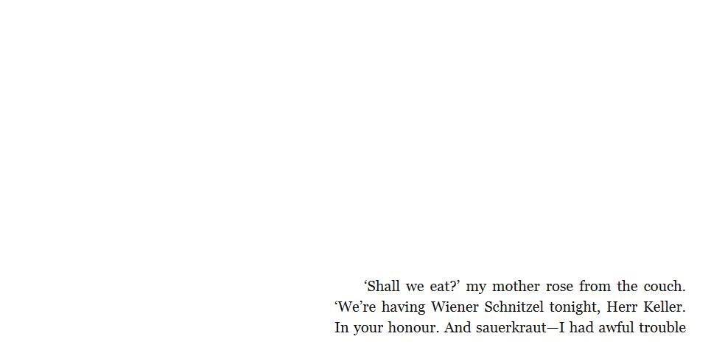

Slide 4
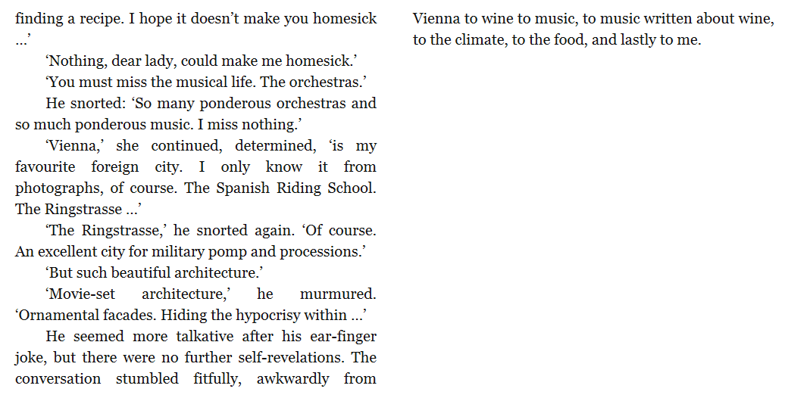

Slide 5
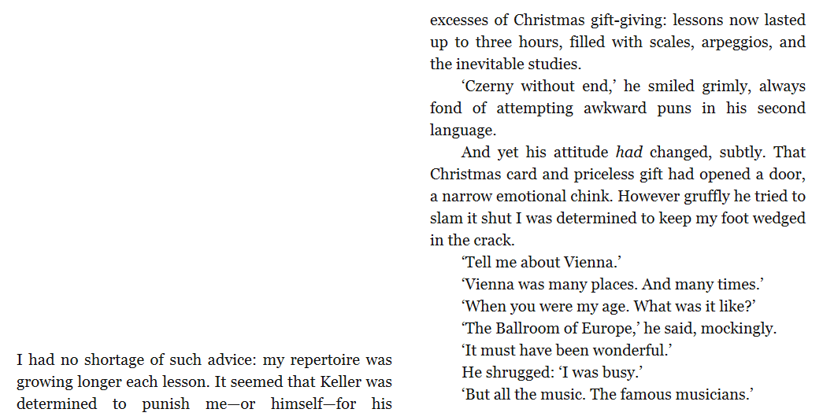

Slide 6
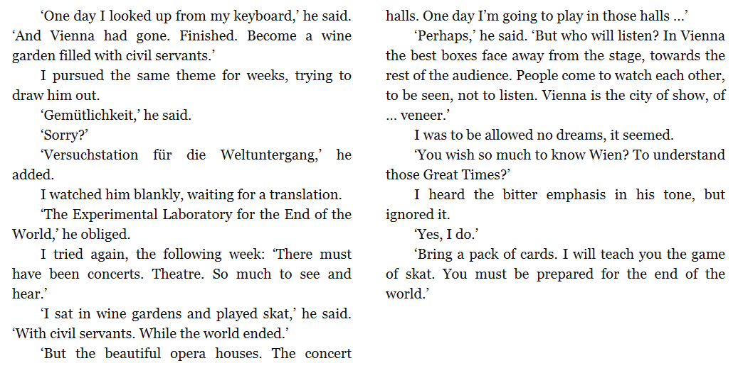

Slide 7
