Slide 1
PURPOSE OF MAESTRO – What Goldsworthy wants us to EXPERIENCE or understand (through Paul’s EXPERIENCES):
Growth and maturity
Relationships (Paul & Keller, plus Paul’s other relationships, plus Keller & his family)
Reflection on life and value of hindsight
Self discovery
Escapism (Keller and his past)

Slide 2
Read Pgs 37-38
DISTINCTIVE IMAGE 4 – Family Portrait
Complete ‘Image Analysis Pro Forma’ – how does this description of Keller’s family portrait help us understand the growing relationship between Keller and Paul. How does it also help us understand Keller’s need for escapism?
Adjectives Capitalisation Rhetorical Q

Slide 3
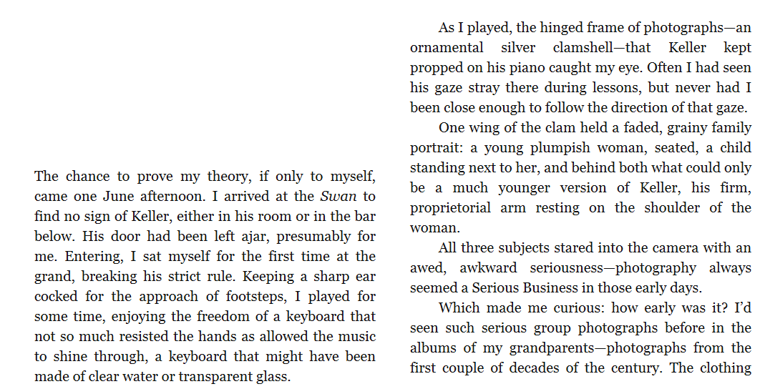

Slide 4
