Slide 1
First impressions of Keller
Darwin

Slide 2
PURPOSE OF MAESTRO – What Goldsworthy wants us to EXPERIENCE or understand (through Paul’s EXPERIENCES):
Growth and maturity
Relationships (Paul & Keller, plus Paul’s other relationships, plus Keller & his family)
Reflection on life and value of hindsight
Self discovery
Escapism (Keller and Darwin)

Slide 3
Read Pgs 17-18
DISTINCTIVE IMAGE 3 – The Swan
Complete ‘Image Analysis Pro Forma’ – how does this description of The Swan help us understand Keller within his environment?
Extended Metaphor Adverbs Adjectives
Onomatopoeia Simile Rhetorical Q

Slide 4
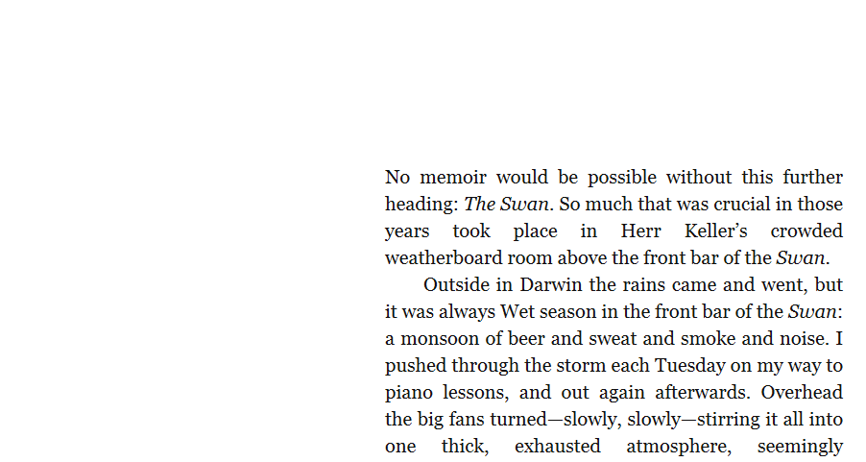

Slide 5
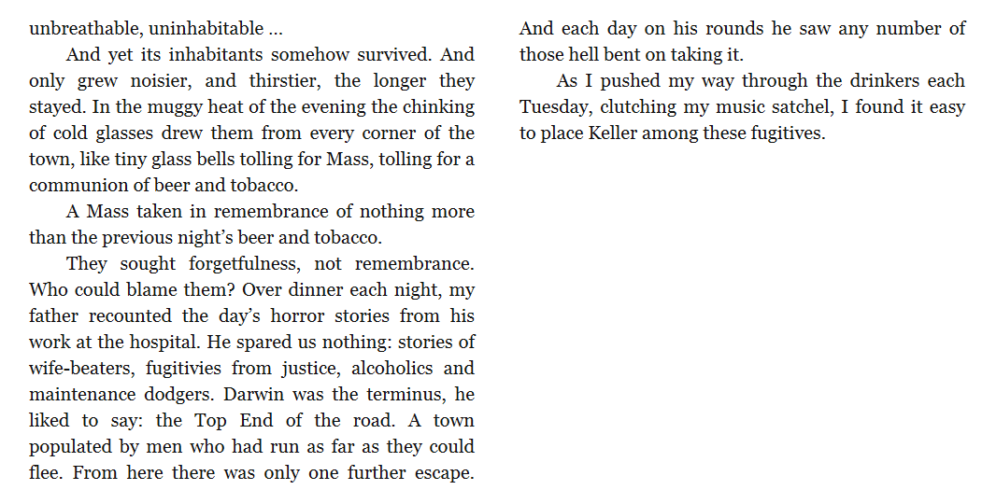

Slide 6
