Slide 1
PURPOSE OF MAESTRO – What Goldsworthy wants us to EXPERIENCE or understand (through Paul’s EXPERIENCES):
Growth and maturity
Relationships (Paul & Keller, plus Paul’s other relationships, plus Keller & his family)
Reflection on life and value of hindsight
Self discovery
Escapism (Keller and Darwin)

Slide 2
Read Pgs 9-10
DISTINCTIVE IMAGE 2 - Darwin
Complete ‘Image Analysis Pro Forma’ – how does this description of setting help us to understand Keller and why he might be in Darwin?
Personification Sensory imagery Adjectives
Adverbs Verbs Repetition
Metaphor Symbolism Rhetorical Q
Exaggeration Oxymoron

Slide 3
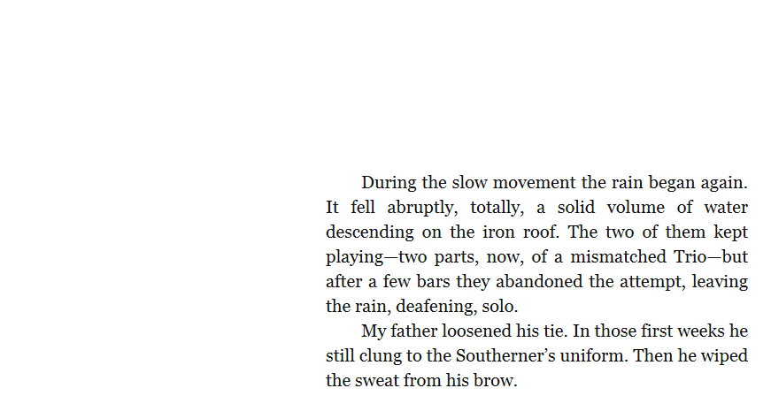

Slide 4
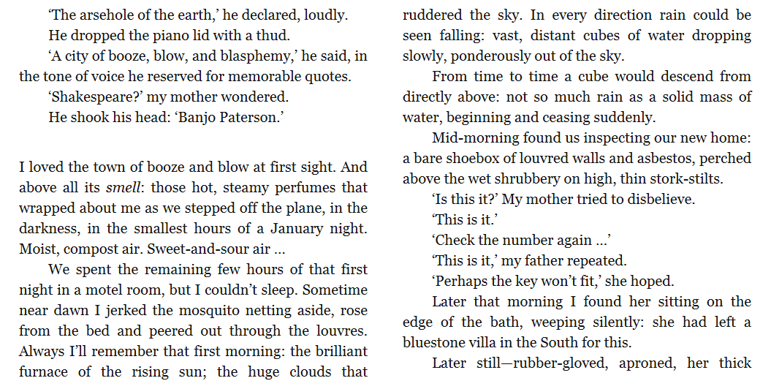

Slide 5
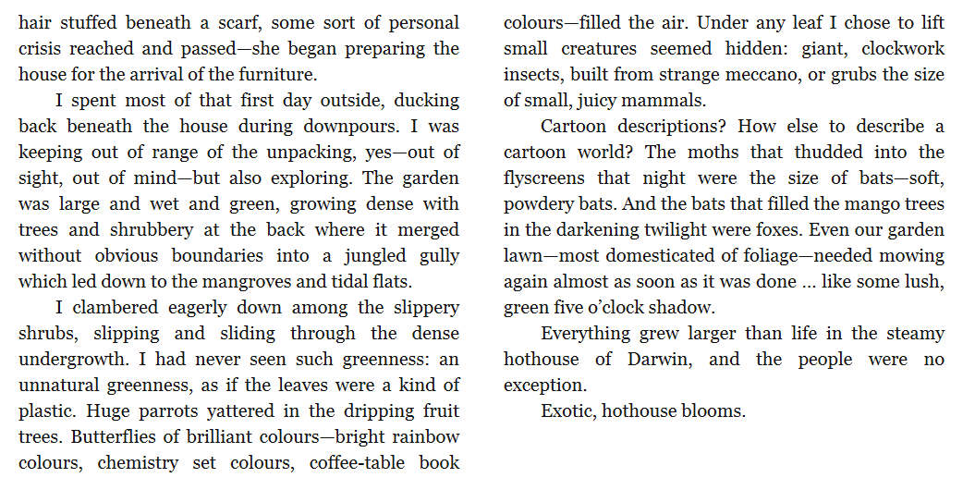

Slide 6
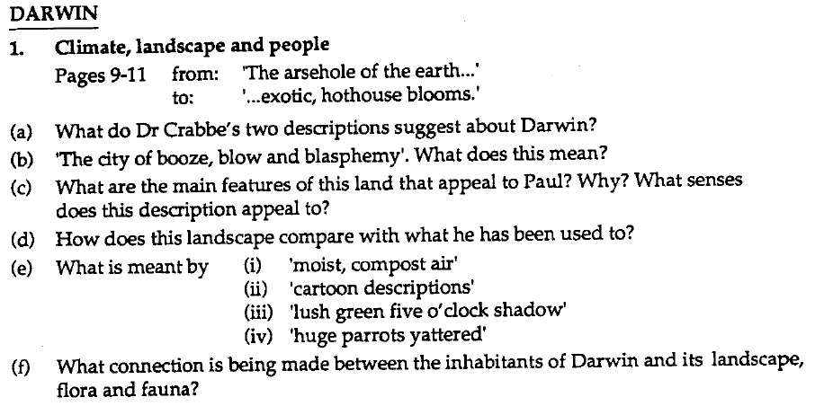
HOMEWORK: Due

