Slide 1
THE 60 SECOND CHALLENGE: YOU HAVE 60 SECS TO WRITE DOWN ALL THOUGHTS WITH REGARDS TO THE QUESTIONS BELOW:
What is the PURPOSE of Maestro?
What is the EXPERIENCE the author wants us to have?

Slide 2
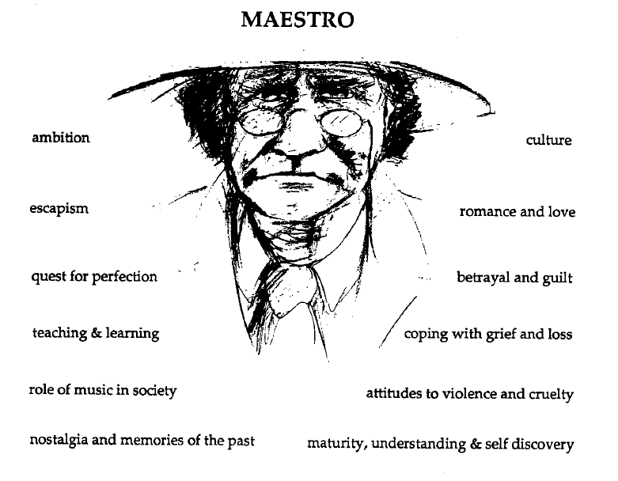

Slide 3
PURPOSE OF MAESTRO – What Goldsworthy wants us to EXPERIENCE or understand (through Paul’s EXPERIENCES):
Growth and maturity
Relationships (Paul & Keller, plus Paul’s other relationships, plus Keller & his family)
Reflection on life and value of hindsight
Self discovery
Escapism (Keller and Darwin)

Slide 4
Read Pgs 3-5
DISTINCTIVE IMAGE 1 - Paul’s First Impressions of Keller
Complete ‘Image Analysis Pro Forma’ – how does this initial description of Keller reveal ideas about Goldsworthy’s purpose? In particular Paul’s relationship with Keller (how it changes) and values of hindsight?

Slide 5
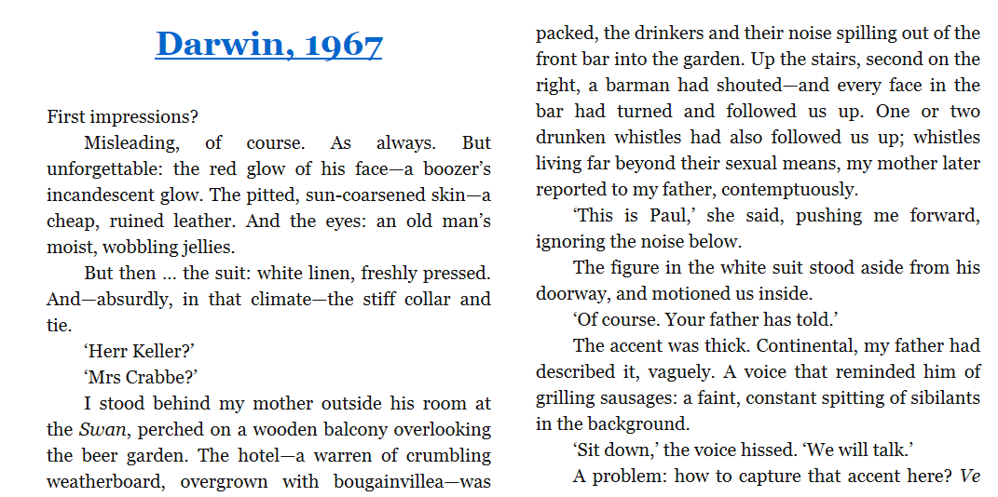

Slide 6
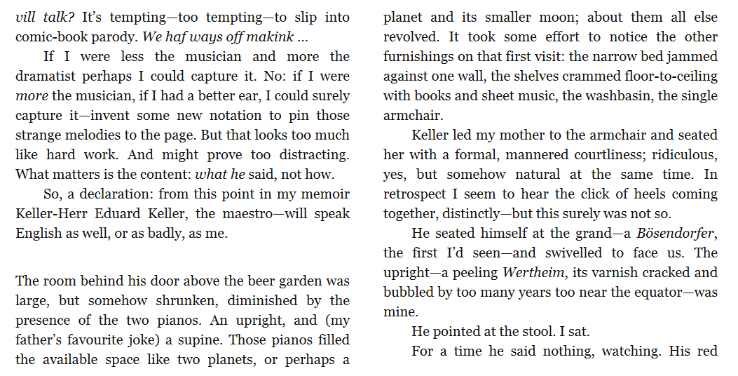

Slide 7
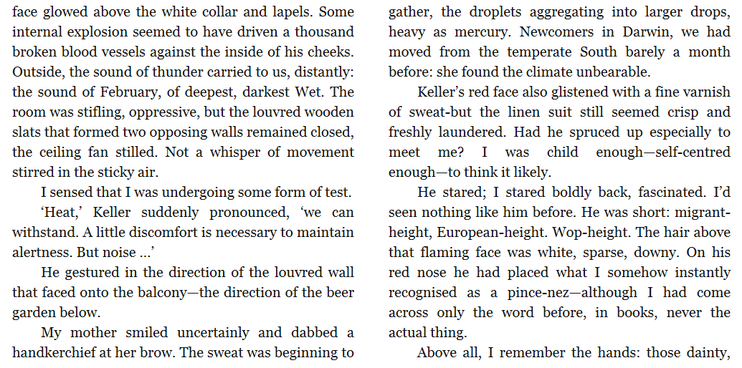

Slide 8
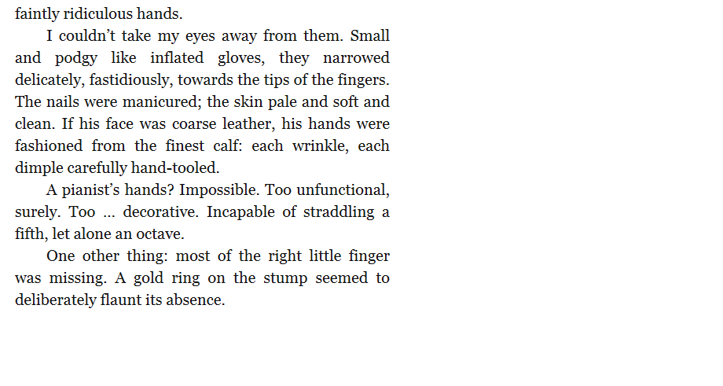

Slide 9
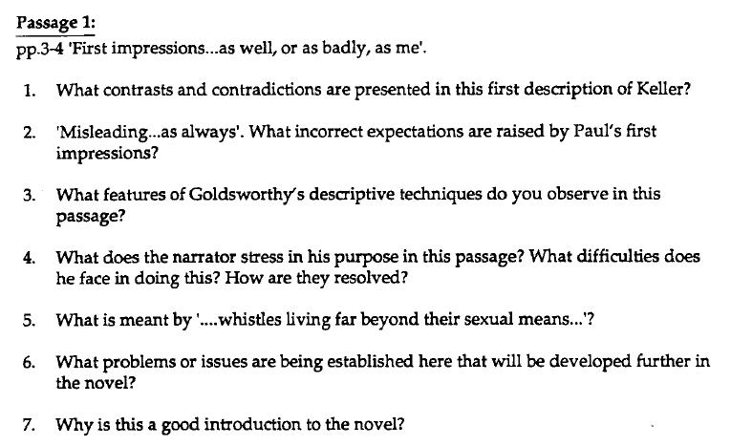
HOMEWORK – KEY SCENE QUESTIONS

