Slide 2
Essay Question
“Discuss how discovery can affect people in different ways”
In your response make detailed reference to your prescribed text and ONE other related texts of your own choosing.

Slide 3
Breaking Down the Question – KEY WORDS
“Discuss how discovery can affect people in different ways.”

Slide 4
Breaking Down the Question
HOW = TECHNIQUES
Type of text = Documentary – therefore, documentary techniques are needed;
Voiceover/narration
Camera angles
Camera shots
Archival Footage from news reports
Graphics
First hand account/interview
Indirect/direct interviews
On-location footage
Soundtrack
Hand-held camera
Understand the Verb.​
Identify issues and provide points for and/or against.
“Discuss how…

Slide 5
Breaking Down the Question
What does discovery mean? Type? Find synonyms for Discovery.
People – group – more than one. Which participants are you going to focus on?
It asks for ways – plural!
“..discovery can affect people in different ways.”
You need to have at least TWO participants that have a DIFFERENT encounter of discovery throughout the social experiment – NOT SIMILAR.
OR
If you have enough analysis for a LONG detailed paragraph ONE participant, you could focus on a DIFFERENT aspect in your RELATED TEXT.
Change; make a difference to; question – again, find synonyms.

Slide 6
Breaking Down the Question
In your response make detailed reference to your prescribed text and ONE other related text of your own choosing.
Think about how you might structure the response before you come up with your ideas. Perhaps you might only have TWO body paragraphs –
Go Back – ONE PARTICIPANT
Related Text?
OR
Go Back with ONE participant and RELATED text link
Go back with ANOTHER (or the same with a different aspect) and RELATED text link

Slide 7
Thesis Statement
Use the question to create your thesis statement. What are you trying to communicate in your essay? Give your opinion.
This statement needs to be direct and rubric driven. Your topic sentences need to be drawn from it.
“Discuss how discovery can affect people in different ways.”

Slide 8
Topic Sentences
Now use the question to create your main arguments. ​
What are you going to argue about the statement?​
These statements will become your topic sentences.​
Remember to avoid repeating the word Discovery and do not include the name of a text. It needs to be based on the question and related to your thesis statement.​
“Discuss how discovery can affect people in different ways.”

Slide 9
Related Texts
Now that you have a clear idea on how you want to argue your essay, choose TWO related texts that will best fit into what you are wanting to communicate.​
Remember the key words of the question. Does your text relate?
“Discuss how discovery can affect people in different ways.”

Slide 10
Plan
How are you going use your Prescribed Text and Related Texts?​
Which individual/s are you going to discuss?​
What was their perspective of themselves and the world?​
What ramifications did they face during their process to discovery?​
How did this change their perspective?​
How was it DIFFERENT to the others in the social experiment?

Slide 11
TEEx4+L Structure
Don’t forget about structure!​
Have a strong introduction and conclusion.​
You may have another acronym that you like to use?
​I like to use TEEx2L
Topic Sentence.
Example and technique of how the topic sentence is evident in Go Back To Where You Came From.
Effect on the audience and the discovery.
Repeat E & E (provide another example/technique.
Link to the question.
YOU MUST INCLUDE DOCUMENTARY TECHNIQUES!!!!

Slide 12
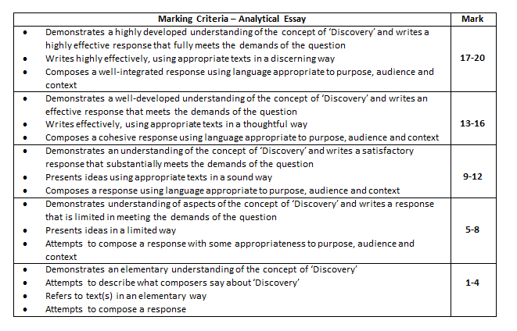
Marking Criteria

Slide 13
Drafts…
YES! Of course we will be collecting drafts
HOWEVER… Make sure you are handing in a draft that you have re-read, edited and had a buddy to check. We can not spend hours fixing your silly mistakes.
TWO drafts MAX for each person – therefore you need to make sure you are happy with each draft to ensure you are getting the maximum feedback from us.
Make sure you apply the feedback – what’s the point of doing a draft if you don’t acknowledge what we are saying.
Use all of the information/quotes/techniques we have been over in class – YOU’VE GOT THIS!

Slide 14
LOW BAND 1/2 SAMPLE ESSAYS
http://boardofstudies.nsw.edu.au/syllabus_hsc/stds-matl/english-std-advanced-paper-1/english-standard-advanced-15-paper1-q3-band-23-sample2.pdf
http://boardofstudies.nsw.edu.au/syllabus_hsc/stds-matl/english-std-advanced-paper-1/english-standard-advanced-15-paper1-q3-band-23-sample1.pdf
http://boardofstudies.nsw.edu.au/syllabus_hsc/stds-matl/english-std-advanced-paper-1/english-standard-advanced-15-paper1-q3-band-12-sample2.pdf

Slide 15
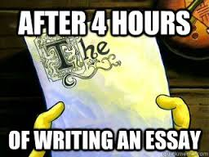
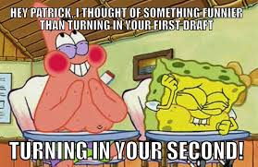
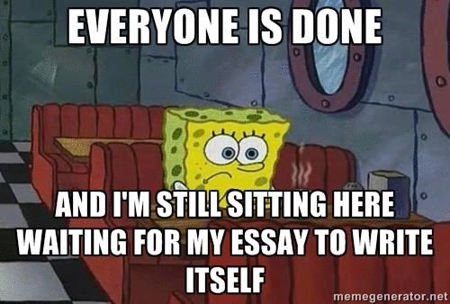
HAPPY ESSAY WRITING!

