Slide 1
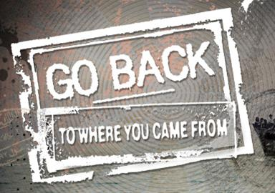

Slide 2
Episode 1
Episode 1 sets up the premise of the show as a social experiment to follow the lives of six ordinary Australians as they encounter the life of a refugee ‘in reverse’. The Australians are introduced through short vignettes, stating their names, where they come from, their age and their employment. They are presented as a type of Australian, typical in a particular way and therefore representing a group of Australians. Their beliefs are heard through the inserted grabs from their own conversations.
Their ‘controller’ is the sociologist Dr David Corlett who states what they can do and where they will go. Less obvious participants are the narrator and the camera. The narrator links sections of film and creates a thread between the stories. He gives facts such as statistics and background history when needed but he also affects the television audience emotionally with the tone of his voice. The point of view constructed through the camera is usually that of a participant, often hand held and even jerky as the cameraman runs after the participants to be part of the action. The footage is further manipulated by editing and overlaid music.

Slide 3
Episode 1
In the first episode the plot is revealed, and the story starts with participants meeting those refugees who have reached the end of their journey and settled in Australia. Participants enter their homes, talk to them and listen to their stories before going to Darwin to embark on a boat trip of their own. The danger on the ocean increases and correspondingly, the camera becomes less controlled and the extradiegetic music becomes louder. The closing sequence reflects the opening sequence and there is a build-up of tension and the suggestion of growing danger creating curiosity in the audience as an encouragement to return for the next night’s viewing.

Slide 4
Opening Sequence
1. Watch the opening montage of the Series – Go Back To Where You Came From.
2. Complete the worksheet – ‘ Analysing the opening sequence’
3. How does the opening sequence frame the discovery to be made?
Go Back opens with grainy television news footage of a boat crashing on to the rocks, presumably off the coast of Australia, as well as images of protests and political leaders making statements to the camera about the arrival of asylum seekers. Simultaneously, the voice-of-God narration, with well-known Australian actor Colin Friels providing the voice-over, tells the viewer: Asylum seekers, refugees … issues that divide a nation…’ This opening sequence immediately signals Go Back’s agenda as a sociopolitical intervention.
Douglas and Graham, 2013, p.129

