Slide 1
Go Back To Where You Came From
Ivan O’Mahoney

Slide 2
Discussion:
Why might contact with other cultures be important?
How important is it to ‘know the facts’ about political events?
Why are people’s stories so important?
What do you think is a ‘moral’ way to act towards people in need?
In what ways can television be influential in changing views and opinions?
How important is social media in changing people’s views?

Slide 3
Introductory Task:
You have two minutes to write down your views/preconceived ideas on Refugees.

Slide 4
Christmas Island Asylum Tragedy - 2010
https://www.youtube.com/watch?v=z1hAwbhoDu0&feature=youtu.be

Slide 5
Research:
Who are asylum seekers?
On what basis may an individual be deemed a refugee?
What reasons may asylum seekers have for leaving their homes?
What rights do asylum seekers have according to international laws such as the Convention relating to the Status of Refugees (1951)?
Outline further discoveries you have made in your research in point form. Identify at least three and new points of interest regarding the issues surrounding asylum seekers.

Slide 6
Website help:
https://www.humanrights.gov.au/our-work/asylum-seekers-and-refugees/asylum-seekers-and-refugees-guide
http://www.asrc.org.au/wp-content/uploads/2013/07/student-resource-kit1.pdf
http://unhcr.org.au/unhcr/index.php?option=com_content&view=article&id=299:new-qex%09%09%09%09cisionq-law-does-not-relieve-australia-of-its-responsibilities-towards-asylum-seekers-unhcr&%09%09%09catid=35:news-a-media&Itemid=63
https://en.wikipedia.org/wiki/Convention_relating_to_the_Status_of_Refugees
http://www.refugeecouncil.org.au/f/rhp-time.php

Slide 7
Link to Discovery?
You have two minutes to write down what you have learnt/discovered/rediscovered from the research.

Slide 8
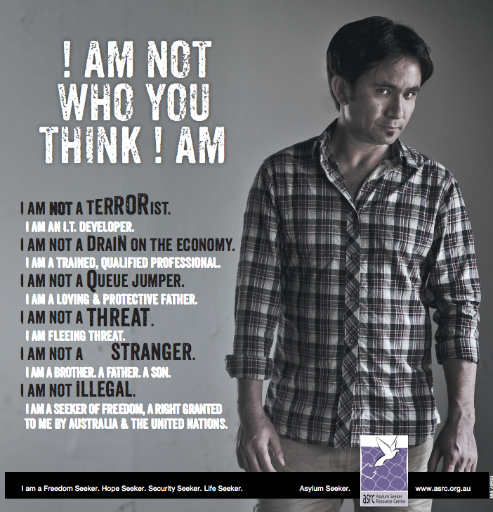

Slide 9
I Am…
Creative Writing Task
Focus on allowing people to discover a little more about you.
What misconceptions may people have? Or perhaps you have the misconceptions about yourself?
You may like to write a poem, diary entry or letter.

