Slide 1
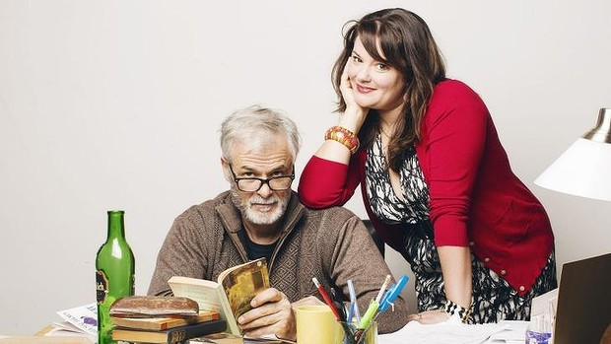
Educating Rita
ETA HSC Module Day
Adapted from Simon Brooks

Slide 2
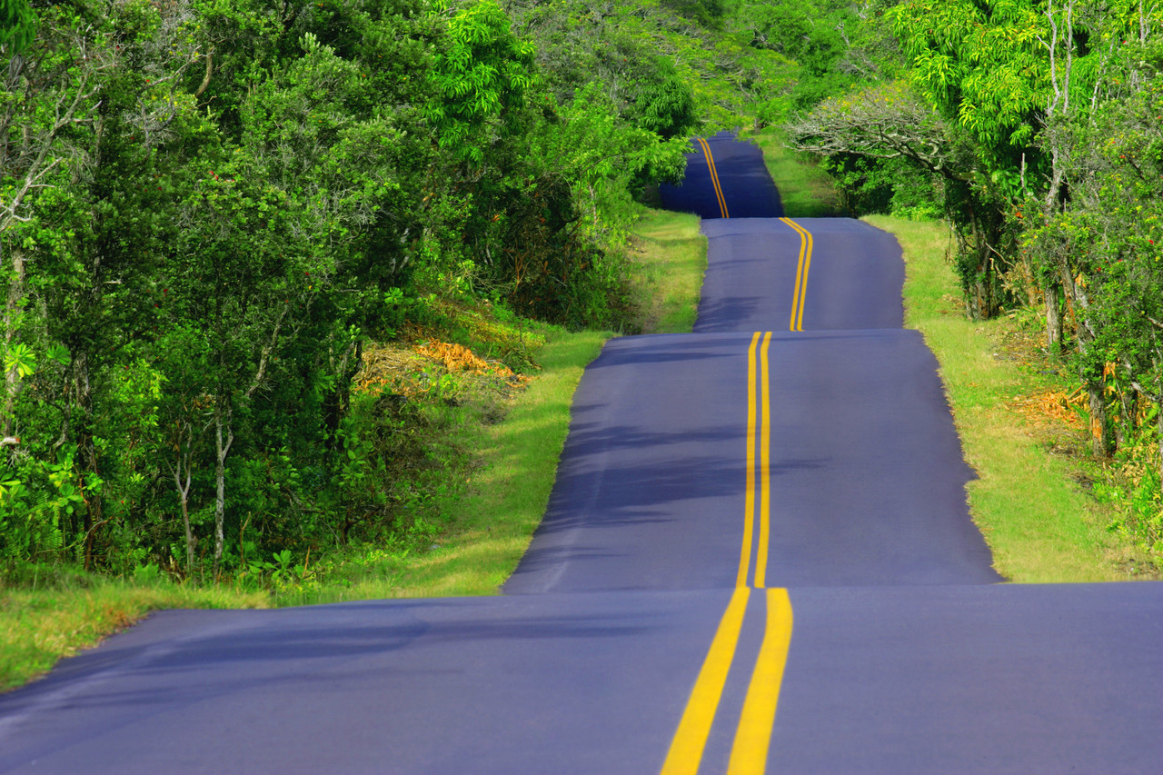
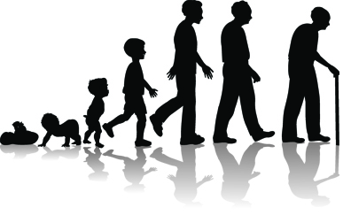
Exploring Transitions
What does it actually mean?

Slide 3
Context
Who wrote Educating Rita?
British playwright, Willy Russell, 1980
Where is the play, Educating Rita, set?
Frank’s office, Liverpool, England
Therefore, what do we need to understand about context?
The play is British.
We need to understand the British social context and humour.
Protagonists?
Rita
Frank
Other characters?
Julia
Denny
Trish

Slide 4
What transitions do the main characters experience?
Working class world
‘Educated’ world
RITA
No choice
Choice
Literal
Figurative
Defeatism
FRANK
Hope
Snobbery
Open-mindedness

Slide 5
Breaking Down the Rubric
WHY: the reasons for transitions (why is it that people feel they need to? Reasons for)
HOW: the process of transition
DIFFICULITIES: The challenges of transition
CONSEQUENCES: the results of transition, both good and bad.

Slide 6
WHY: The Reasons for Transition
Rita feels stifled by her working class ideology.
Remember the class divisions in 1980s Liverpool, England
We don’t really have any class division in Australia
Class – be clear on what they mean
Working
Middle – not born into wealth or heritage – comes from a self made opportunity. It’s about values – open minded. Appreciating different values – generalisations.
Upper – born into privilege, into property, people have titles off them from the system (Downtown Abbey, Gossip Girl etc) – NOT DICTATED BY WEALTH.

Slide 7
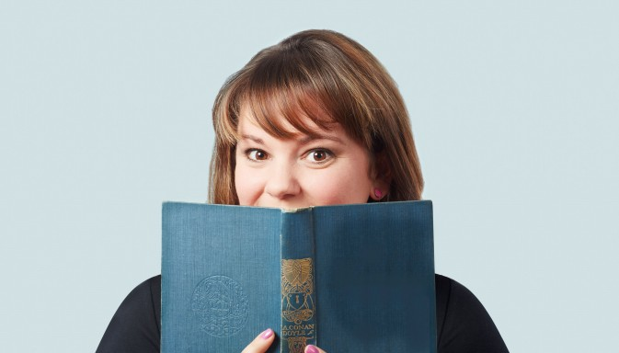
Texts and Society
Our module is – texts and society
Elective: Exploring Transitions
We need to understand the context and class of Rita to analyse the texts in details.

Slide 8
British Culture
Rita: I’m twenty-six. I should have had a baby by now; everyone expects it. (12)
Rita is experiencing a culture that have these social expectations.
She wants something more than this.
Breaking away from conformity and do something different with her life.
She desires a purpose.

Slide 9
Bathos
Rita: I told him [Denny] I’d only have a baby when I had a choice. But he doesn’t understand. He thinks we’ve got choice because we can go into a pub that sells eight different kinds of lager. He thinks we’ve got choice already: choice between Everton an’ Liverpool, choosin’ which washing power, choosin’ between one lousy school an’ the next, between lousy jobs or the dole, choosin’ between Stock an’ butter. (34)
Technique – bathos and humour
Bathos - abrupt transition from sublime to commonplace
Denny’s notion of choice is humourous through the use of bathos.
The use of bathos implies that…

Slide 10
Metaphor
RITA: There’s like this sort of disease, but no one mentions it; everyone behaves as though it’s normal, y’ know inevitable that there’s vandalism an’ violence an’ houses burnt out an’ wrecked by the people they were built for. (30)
…. What are they tellin’ people to do? They just ell them to go out and get more money, don’t they?... It’s like me, isn’t it… Y’ know, buyin’ new dresses all the time, isn’t it… (30)
Metaphor of disease: describes lack of purpose and meaning in life.
Identifying it as an illness
She doesn’t feel she correlates with this idea
Use of rhetorical questions – looking for clarification? To know she is right?

Slide 11
Metaphor
RITA: I just like talkin’ to y’. It’s great. That’s what they do wrong in schools y’ know – they get y’ talkin’ an’ y’ all havin’ a great time talkin’ about somethin’ an; the next thing they wanna turn it into a lesson. We was out with the teacher once, y’ know outside school, an’ I’m right at the back with these other kids an’ I saw a fantastic bird. All coloured it was, like dead out of place round our way. I was gonna shout an’ tell Miss but this kid next to me said, ‘Keep you mouth shut or she’ll make us write an essay on it.’
FRANK: (sighing) Yes, that’s what we do, Rita; we call it education
Rita: Tch. Y’d think there was somethin’ wrong with education to hear you talk. (22)

Slide 12
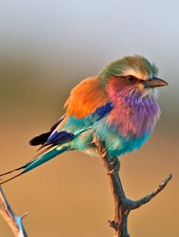
Metaphor
Look what is inside Rita
Culture she is in “or she will make us write an essay”
Metaphor for Rita - values difference
Working class expectations encourage intellectual apathy (state of indifference repressing enthusiasm) – Rita craves open-mindedness – and she says, ‘I wanna see’ (6) – METAPHOR – she doesn’t want to have to ignore it.

Slide 13
HOW: The Process of Transition

Slide 14
RITA
Act One – the beginning of the process.
RITA: I was dead surprised when they took me in. I don’t suppose they would have if it’d been a proper university. The Open University’s different though, isn’t it? (4)
RITA: Degrees for dishwashers(4) – paradox
Open University – what is it?
You can enter as a mature student
Don’t need any qualifications
Paradox – a statement that sounds contradictory but somehow makes sense

Slide 15
RITA
Rita’s positive attitude remains throughout the play.
Rita: But these women, you see, they come to hairdresser’s cos they wanna be changed. But if you want to change y’ have to do it from the inside, don’t y? Know, like what I’m doin’. Do you think I’ll be able to do it? (11)
Real transition comes from intellectual rather than cosmetic change. It feels superficial for Rita. She thinks Education will help to change this.
Techniques
Metaphor
Rhetorical and open questions

Slide 16
FRANK
Frank had exposure to a fresh ideology, resulting in a paradigm shift for him – how you look at the world (if you look at the world how you expect to see joy)
Rita is a breath of fresh air.
A whole new being and thinking
Rita: That’s a nice picture (3)
I don’t think I’ve looked at it in 10 years
Shakes him out of a the paradigm he is in and he is exposed to something fresh and new – cause for transition
Assonance – “I’ve never really never looked at it like that” (8)
Metaphor of looking
Rita is making him look in a whole new light

Slide 17
DIFFICULTIES: The Challenges of Transition
Cultural divide:
FRANK: You are?
Rita: What am I?
FRANK: Pardon?
RITA: What?
FRANK: Now you are?
RITA: I’m a what? (2-3)
Linguistic humour
He is coming from a middle class context – Rita doesn’t know that code when ‘You are” – it’s like they are speaking a different language.
The linguistic humour is due to the cultural divide between the protagonists.
FRANK: [refering to Rita using the phrase] (With an exaggerated look at her) What in the name of God is being off one’s cake?

Slide 18
Cultural Divide
Frank: Do you know Yeats?
Rita: The wine lodge? (8)
Unintentional punning by Rita
Cultural divide
Why does the cultural divide
make the transition challenging?

Slide 19
Status Quo
The allure of status quo (stay the same – very appealing not to bother)
Due to societal expectations
https://www.youtube.com/watch?v=ZYZpZr3Cv7I
Rita describes working class expectations ‘like what you’ve got to be into is music an’ clothes an’ lookin’ for a feller, y’ know the real qualities of life. .. There was always somethin’ in my head, tappin’ away, tellin’ me I might have got it all wrong. But I’ld just play another record or buy another dress an’ stop worryin. There’s always something to make you forget about it. (17)

Slide 20
Is this it? Is this the absolute maximum I can expect from this livin’ lark? An’ that’s the big moment that one, that’s the point when y’ have to decide whether it’s going to be another changed of fress or a change in yourself.
Society expectations – … it doesn’t upset anyone around y’. Like cos they don’t want to change. (17-18)
Techniques: Irony & metaphor.
‘REAL’ qualities of life
She doesn’t mean that – she is highlighting that working class expectations are those things
Dress
Metaphor for just carrying on and giving in to the status quo

Slide 21
Societal Pressure to avoid Transition
Rita: I see him lookin’ at me sometimes, an’ I know what he is thinking, I do y’ know, he’s wondering where the girl he has married has gone to. He even brings me presents sometimes, hopin’ that the presents ‘ll make her come back. But she can’t because she’s gone, an’ I’ve taken her place. (33)
Use of third person highlights her sense of personal differentiation
She has become two people (pronoun)
The pressure of being caught between two worlds: I’m a freak .. half caste” (45) – the transitionary results alienations

Slide 22
RESULTS: The results of transition
View the end of Act 2 Scene 5 from the Lewis Gilbert 1983 film version of the play.
https://www.youtube.com/watch?v=Uo_BlCo50kc
1:22:02
What are the potentially negative consequences of Rita’s transition into a new phase?

Slide 23
Results
Rita: I know what clothes to wear, what wine to buy, what plays to see, what papers and books to read. I can do with out you.
FRANK: Is that all you wanted. Have you come all this way for so very, very little. (68)
Results: one set of insignificant concerns exchanged for another?
Frank: Found a culture have you, Rita? Found a better song to sing have you? No – you’ve found a different song, that’s all – and on your lips its shrill and hollow and tuneless. (68)

Slide 24
Progression
The idea of the ‘song’ that has develop throughout the course – you could refer to this reoccurring motif throughout your essay.
(Refer to p.46 – Rita talks of a working class song)
Song a metaphor for a new sense of purpose, but Frank suggest it is not a ‘better’, only ‘different’
Singing reference
It seems like they are all happy because they are all one voice
We could sing better songs
Rita wants to be able to sing better songs – works for her – wants to be different from the rest.
Yes you’ve become educated but you haven’t gained anything from it.
What you’ve got is not better it’s just different.

Slide 25
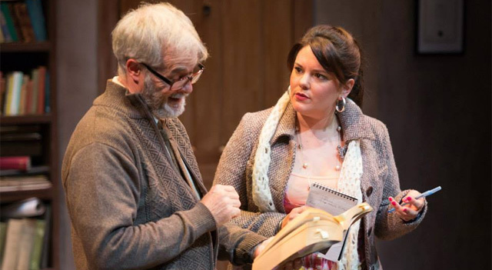
Consequences
But perhaps these negative consequences are more about Frank than Rita?
Frank : (after a pause) It struck me that there was a time when you told me everything (64)
The problem is more about him than her
Jealous of her transition because he hasn’t experienced one

Slide 26
Rita’s Transition
The main benefit of transition for Rita:
RITA: But I chose not to. I had a choice. I did the exam. (72)
RITA: But I had a choice. I chose, me. Because of what you’d given me I had a choice.
RITA: I dunno. I might go to France. I might got me mother’s. I might have a baby. I dunno. I’ll make a decision, I’ll chose. (72-23)
Repetition/Anaphora of choice (highlights the importance for Rita),
Short utterances (show how powerful this moment is for her),
Semi-incredulous tone shows – Rita’s transition into a new paradigm of choice is complete
What education provides is more options!
Thesis statement: how does transition change sense of identity and our mindset?

Slide 27
Frank’s Transition
Does Frank experience a beneficial transition?
Frank: I hear very good things about Australia… It’d be good for us to leave a place that’s just finishing for one that’s just beginning.
RITA: Isnt that just called jumpin’ a sinkin’ ship?
That is how British people think about Australia
The promised land of opportunity
England is finishing
Rita employs a metaphor
Abandoning a ship because its going down – instead of trying to save it
A sense of a new beginning but also a lingering defeatism. The old, cynical Frank has not disappeared as a result of his relationship with Rita, but perhaps she has helped endow him with a new zest for life.

Slide 28
Essay Question
Elective 2: Exploring Transitions
To what extent are the perceptions of others confirmed or challenged by the ways in which they experience transitions in their lives?
Discuss this view with references to Educating Rita and ONE other related text of your own choosing.

Slide 29
Structure
Content words? Task words? Limited words?
Use your knowledge not just what you got from the teacher – makes the markers know that you have gone the extra 110%
Explore the notion of transitions in a powerful way.

Slide 30
Essay Question
2012 Exam Question (adapted)
The experience of transition into new phases of life both limits and extends individual freedom.
Discuss this view with references to Educating Rita and ONE other related text of your own choosing.

Slide 31
Related Text
‘Kid’ Simon Armitage – Poem
Robin becomes a fictional persona in this poem
It would be tough to be Robin – always the second person
Never the hero, always the backup
It deals with the negativity he holds in his heart for Batman
He describes himself/Robin as a shadow.
Stewing over chicken giblets – imagery, bathos, sudden unexpected from the sublime oppressive – we don’t think about him doing this – we think about him saving the world.
The imagery is suggesting batman has been left behind
It’s about how one personas transition and growth could be linked to somebodies else’s climb to power.
https://www.youtube.com/watch?v=ZpR7MoWJ0F8

Slide 32
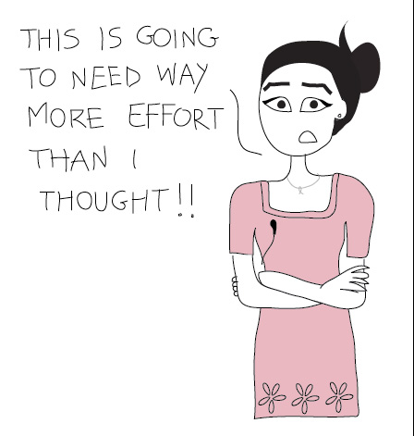
The HSC….
http://www.timeanddate.com/countdown/generic?iso=20151012T1020&p0=240&msg=HSC+English+Paper+One&swk=1

